Slide 1
Development of an App for tracking Low Back Pain in patients
CLINICAL ATTACHMENT PROJECT
Rohan Singh
M.tech Clinical Engineering

Slide 2
The Problem
Low back pain is a recurrent and persistent disorder
It can be short lived or persistent
Therefore, repeated measurements over extended period of time should be taken to classify and understand trajectories of the LBP
The project involves development of App that can take repeated measurements for pain intensity, triggers, pain progression throughout the day, and sleep quality.

Slide 3
OBJECTIVES
To develop, deploy, collect data, and analyse the trajectory of patients with chronic low back pain.
Work Done
Developed Android application with android studio and deployed for tracking low back pain.
Secure Data storage with google sheets implementation

Slide 4
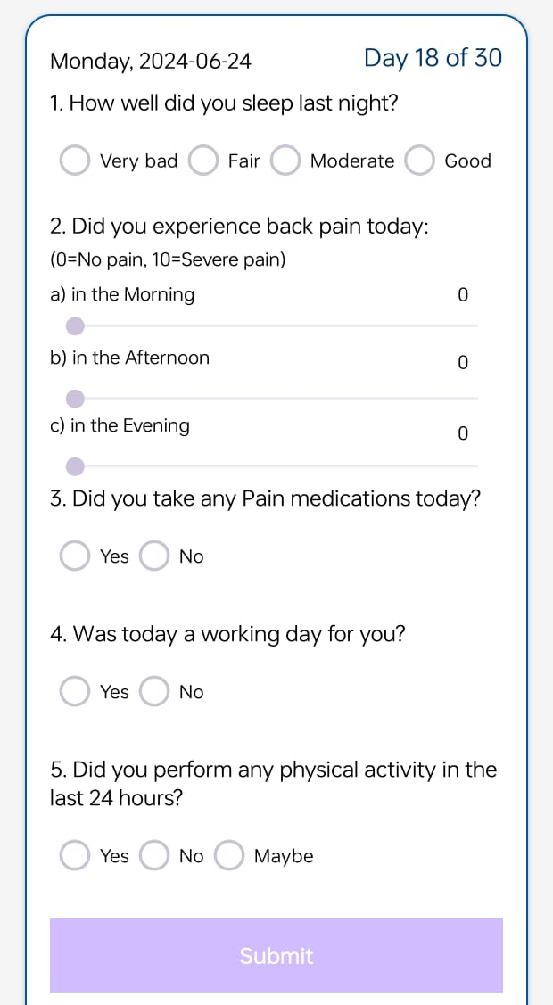
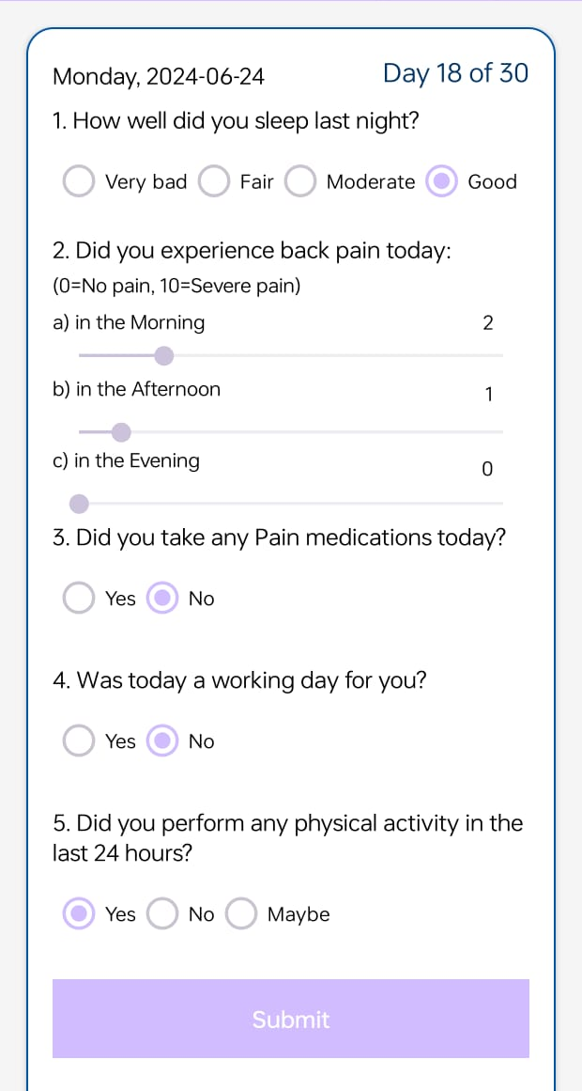
App functionalities
Only Authenticated users can login and submit responses
Ensuring only one response per user per day is recorded
Reminding notifications at 5 to 9 pm intervals
Data handling for different scenarios of internet connectivity
Data storage with Google sheet integration and SQL database for local storage
User interface of the app

Slide 5
Future Aspects
Clinical testing of the app
Distribution of app among diverse group of patients
Data Refining and Data analysis

